Slide 1

dAta hackathon 2.0
TEAM BLUE

Slide 2
MAIN OBJECTIVES
DATA VISUALIZATION
DATA ANALYSIS
DATA MODELLING

Slide 3
DATA ANALYSIS
SUMMARIES: “PSYC”
TABLES:
Central Tendency
Dispersion of Data
Kurtosis
Frequency
Probability
Percentages

Slide 4
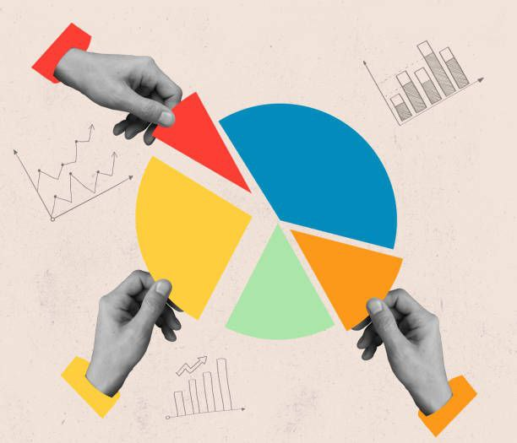
DATA VISUALISATION
ggplot2
ggtheme
ggtheme

Slide 5

DATA MODELLING
RANDOM FOREST CLASSIFICATION
SUPERVISED LEARNING

Slide 6
PRELIMINARY DATA ANALYSIS
SUMMARY

Slide 7
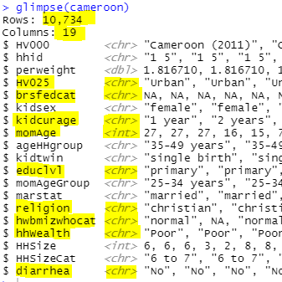
INTRODUCTION
Number of observations
Number of attributes
Meaningful variables
Missing data

Slide 8
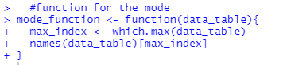
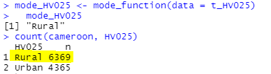
CENTRAL TENDENCIES
Why not mean or median
Why mode
Why a function
Prove of functions efficiency

Slide 9
MEASURES OF DISPERSION
Measures of Dispersion that exist.

Slide 10
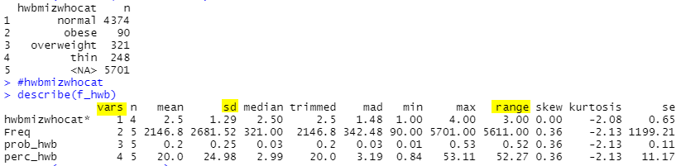
Reference

Slide 11
MEASURES OF DISPERSION
Measures of Dispersion that exist.
Which measures of dispersion are appropriate at the nominal level

Slide 12
MEASURES OF DISPERSION
Measures of Dispersion that exist.
Which measures of dispersion are appropriate at the nominal level
Why are the measures of dispersion not approprate

Slide 13
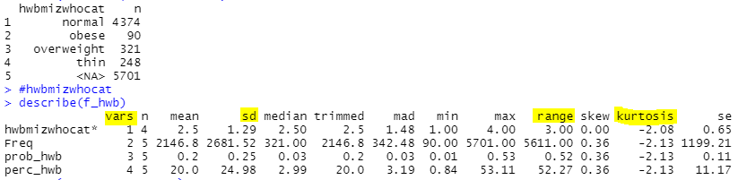
Reference

Slide 14
Kurtosis
Were the values positive or negative

Slide 15
Kurtosis
Were the values positive or negative.
Which type of kurtosis is it by the sign of he values.

Slide 16
Kurtosis
Were the values positive or negative.
Which type of kurtosis is it by the sign of he values.
How is the shape described then.

Slide 17
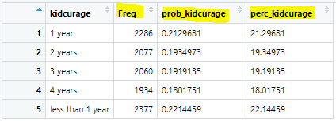
TABLES
Frequency to organize the dataset.
Probability to get the percentage.
Percentage for visualization.

Slide 18
VISUALIZATION
CHARTS AND GRAPHS

Slide 19
VISUALISATION
Use percentage frequencies to create pie charts

Slide 20
VISUALISATION
Use percentage frequencies to create pie charts
Use simple frequency distribution to create bar Graphs.

Slide 21
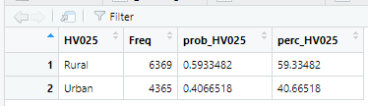
Table For the Residency

Slide 22
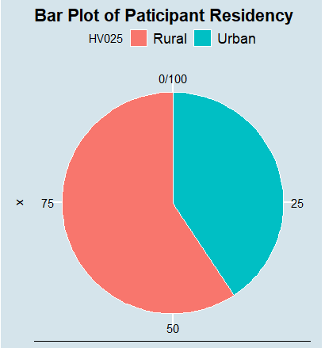
GRAPH OF RESIDENCY

Slide 23
Table for kids Age

Slide 24
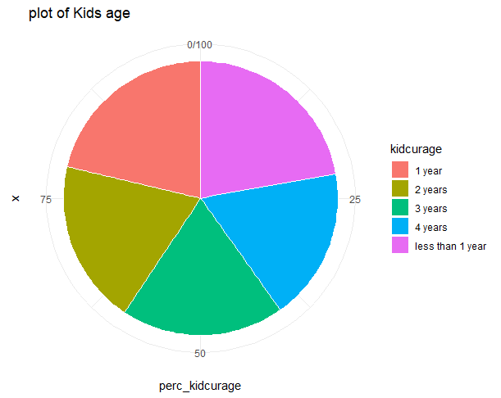
GRAPH OF KIDS AGE

Slide 25
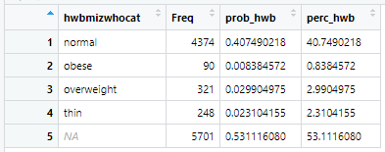
Table of Women BMI status

Slide 26
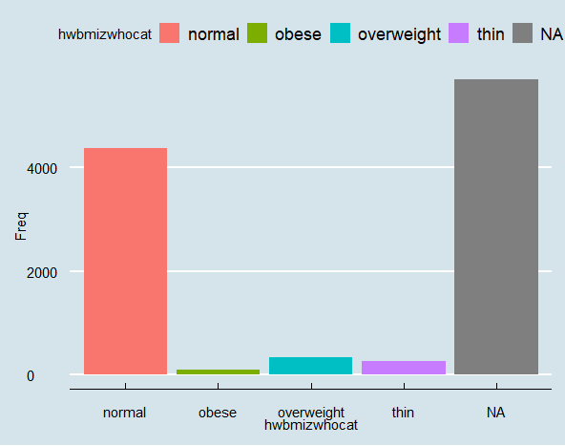
GRAPH OF WOMEN BMI STATUS

Slide 27
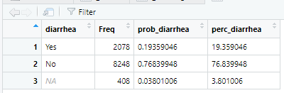
Table of Diarrhea

Slide 28
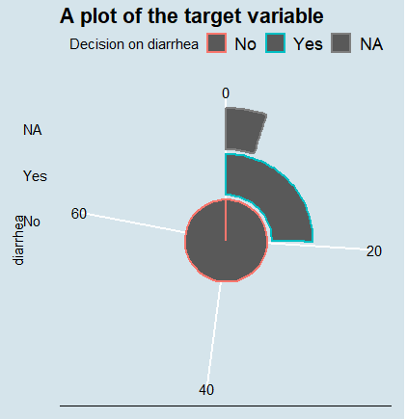
GRAPH OF DIARRHEA

Slide 29
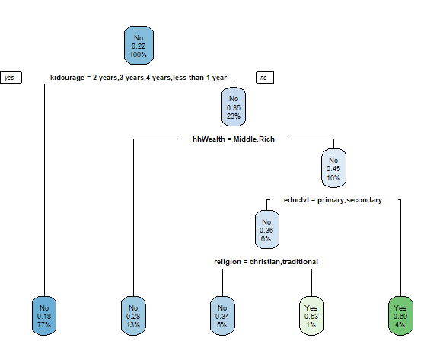
DATA MODELLING
Visualizing the Model

Slide 30
DATA MODELING
Cleaning the data set to eliminate missing values
Create data Frame that contains only the target variable and important data
partitioning the Dataset ~ train_set = 70% test_set = 30%
Train the decision tree classifier
Predicting
confusion matrix for evaluating the model

Slide 31
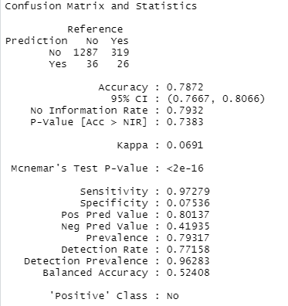
DATA MODELLING
confusion matrix for evaluating the model

